Slide 1
Unit 4
Trees
Objectives
Upon completion you will be able to
Explain Basic Tree concepts.
Implement Binary search tree (BST)
Understand AVL trees
Data Structures: A Pseudocode Approach with C

Slide 2
A Tree consists of a finite set of elements, called nodes, and a finite set of directed lines, called branches, that connect the nodes.
The number of branches associated with a node is the degree of the node.
When the branch is directed toward the node, it is an indegree branch
When the branch is directed away from the node, it is an outdegree branch.
The sum of the indegree and outdegree branches is the degree of the node.
Data Structures: A Pseudocode Approach with C

Slide 3
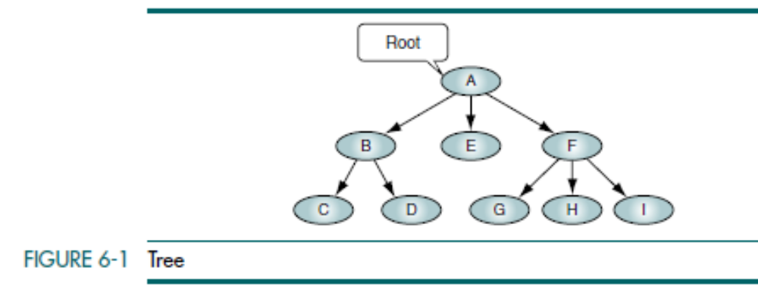
If the tree is not empty, the first node is called the root. The indegree of the root is zero.
Data Structures: A Pseudocode Approach with C

Slide 4
A leaf is any node with an outdegree of zero, that is, a node with no successors.
A node that is not a root or a leaf is known as an internal node.
A node is a parent if it has successor nodes—that is, if it has an outdegree greater than zero.
A node with a predecessor is a child. A child node has an indegree of one.
Two or more nodes with the same parent are siblings.
An ancestor is any node in the path from the root to the node.
A descendant is any node in the path below the parent node; that is, all nodes in the paths from a given node to a leaf are descendants of that node.
A path is a sequence of nodes in which each node is adjacent to the next one. Every node in the tree can be reached by following a unique path starting from the root.
The level of a node is its distance from the root. Because the root has a zero distance from itself, the root is at level 0.
Data Structures: A Pseudocode Approach with C

Slide 5
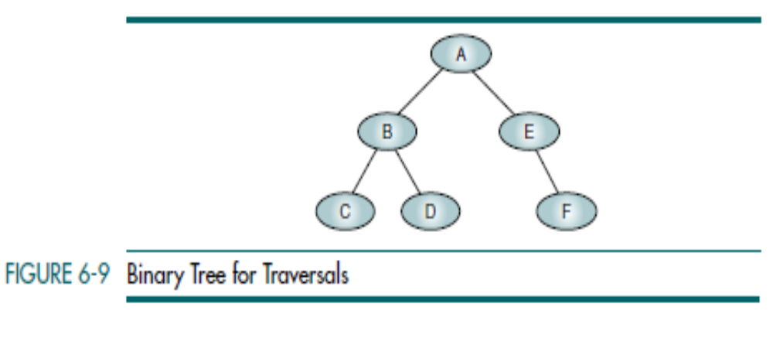
Data Structures: A Pseudocode Approach with C

Slide 6
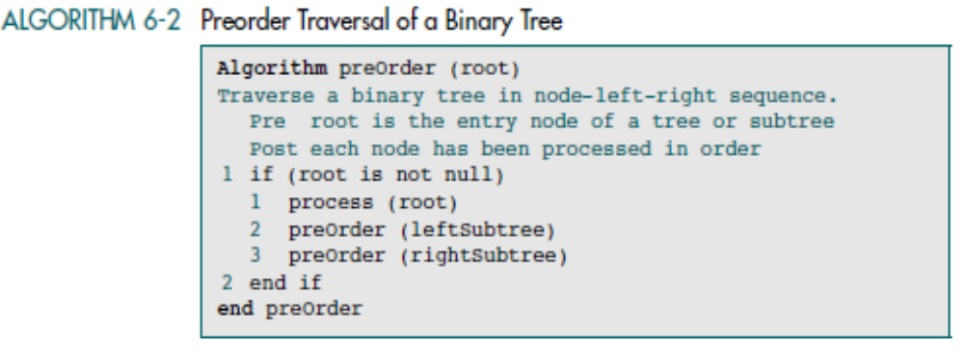
Preorder Traversal (NLR)
In the preorder traversal, the root node is processed first, followed by the left subtree and then the right subtree. It draws its name from the Latin prefix pre, which means to go before. Thus, the root goes before the subtrees.
Data Structures: A Pseudocode Approach with C

Slide 7
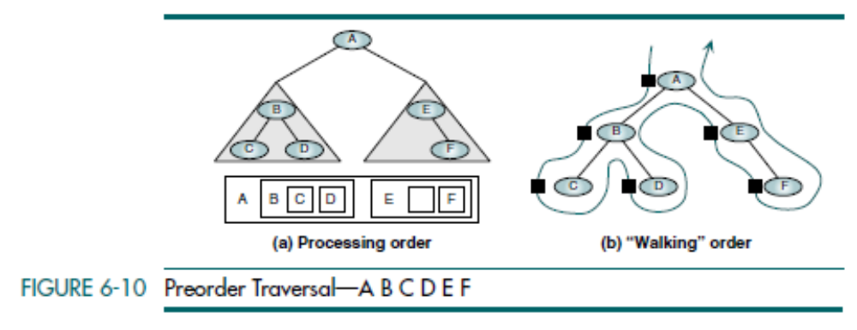
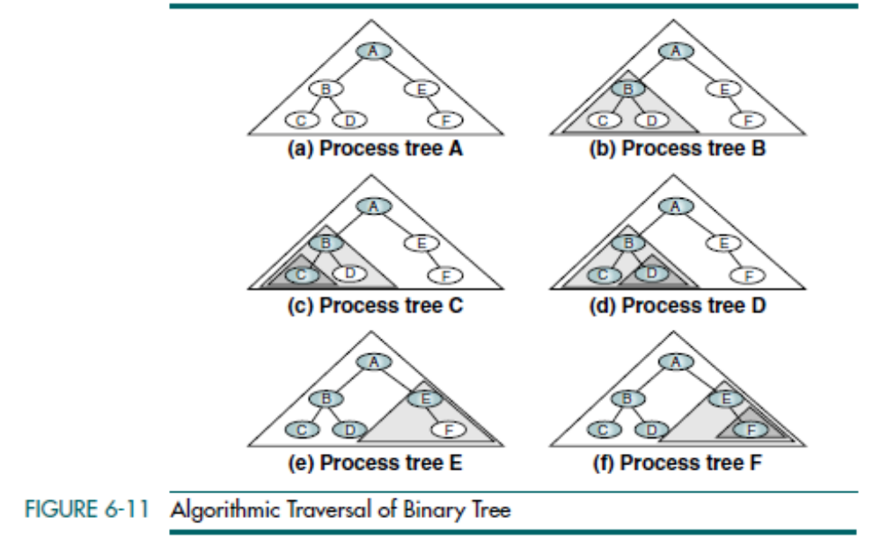
Data Structures: A Pseudocode Approach with C

Slide 8
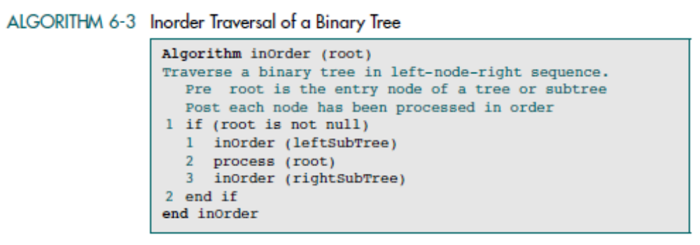
Inorder Traversal (LNR)
The inorder traversal processes the left subtree first, then the root, and finally the right subtree. The meaning of the prefix in is that the root is processed in between the subtrees.
Data Structures: A Pseudocode Approach with C

Slide 9
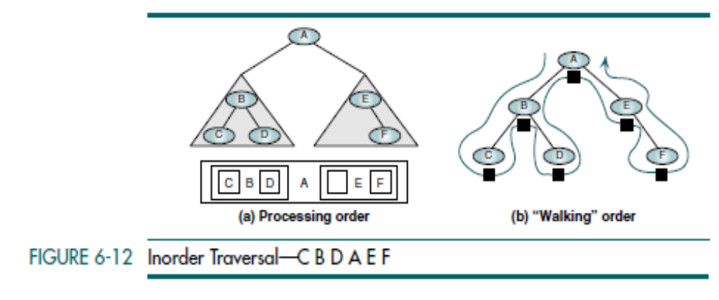
Data Structures: A Pseudocode Approach with C

Slide 10
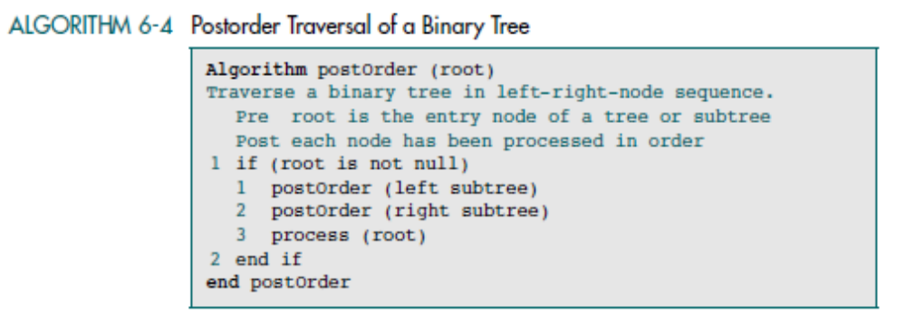
Postorder Traversal (LRN)
The last of the standard traversals is the postorder traversal. It processes the root node after (post) the left and right subtrees have been processed. It starts by locating the far-left leaf and processing it. It then processes its right sibling,
including its subtrees (if any). Finally, it processes the root node.
Data Structures: A Pseudocode Approach with C

Slide 11
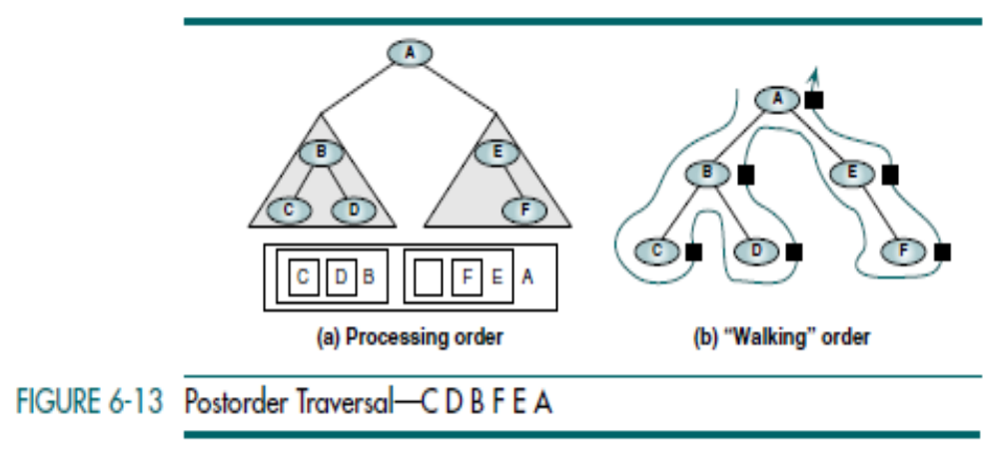
Data Structures: A Pseudocode Approach with C

Slide 12
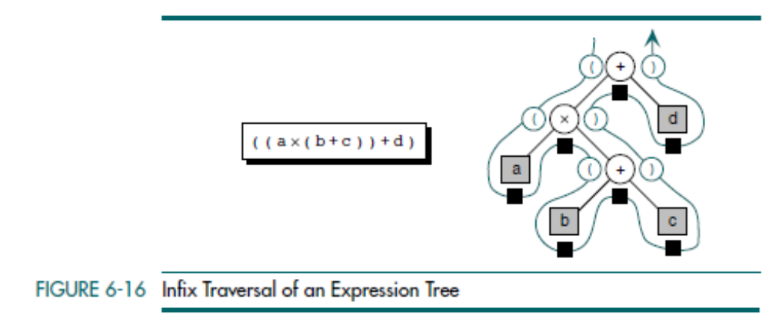
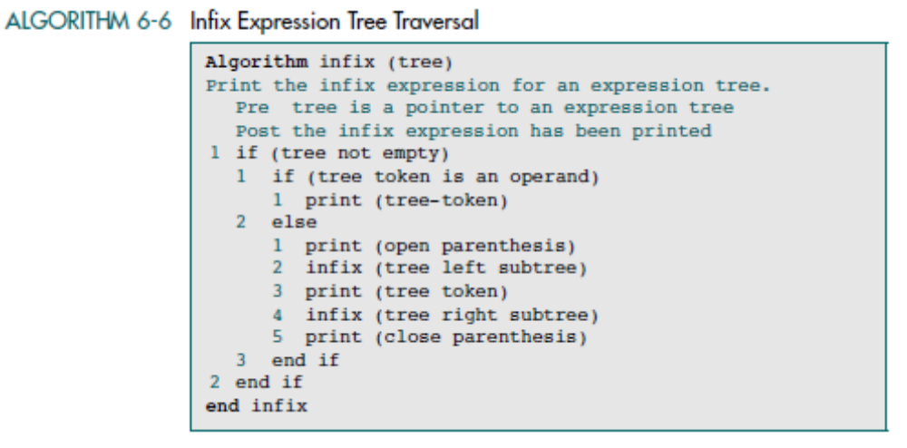
Data Structures: A Pseudocode Approach with C

Slide 13
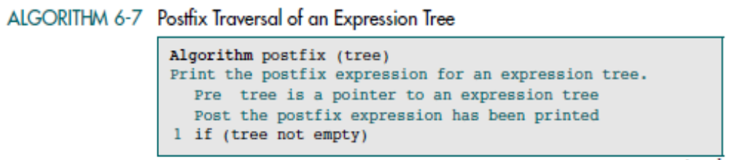
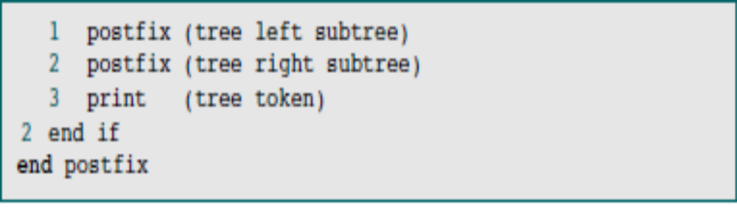
Data Structures: A Pseudocode Approach with C

Slide 14
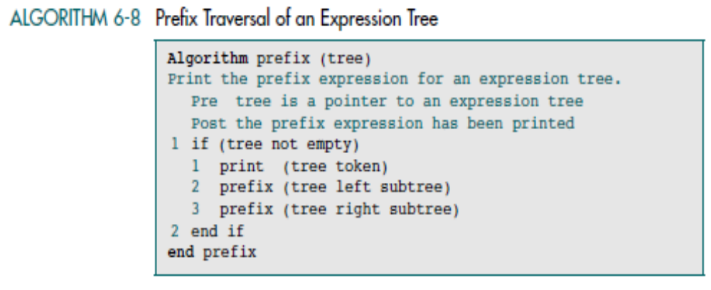
Data Structures: A Pseudocode Approach with C

Slide 15
BINARY SEARCH TREE (BST)
Data Structures: A Pseudocode Approach with C

Slide 16
In the design of the linear list structure, we had two choices: an array or a linked list.
The array structure provides a very efficient search algorithm but its insertion and deletion algorithms are very inefficient.
On the other hand, the linked list structure provides efficient insertion and deletion, but its search algorithm is very inefficient.
What we need is a structure that provides an efficient search algorithm and at the same time efficient insert and delete algorithms.
The binary search tree and the AVL tree provide that structure
Data Structures: A Pseudocode Approach with C

Slide 17
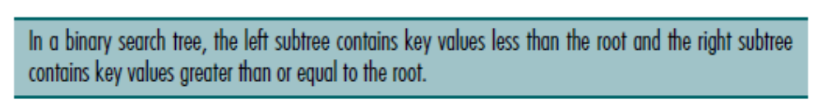
BINARY SEARCH TREE (BST)
A binary search tree (BST) is a binary tree with the following properties:
• All items in the left subtree are less than the root.
• All items in the right subtree are greater than or equal to the root.
• Each subtree is itself a binary search tree.
Data Structures: A Pseudocode Approach with C

Slide 18
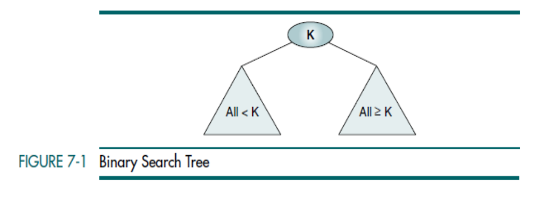
Data Structures: A Pseudocode Approach with C

Slide 19
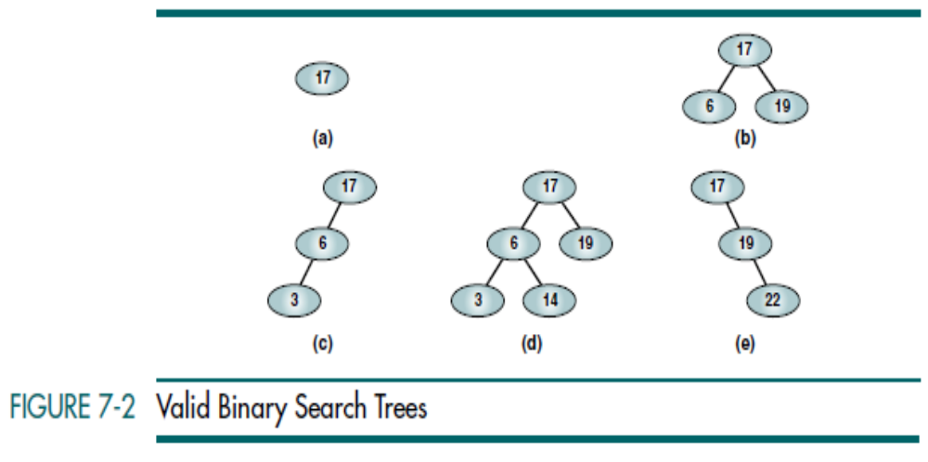
Data Structures: A Pseudocode Approach with C

Slide 20
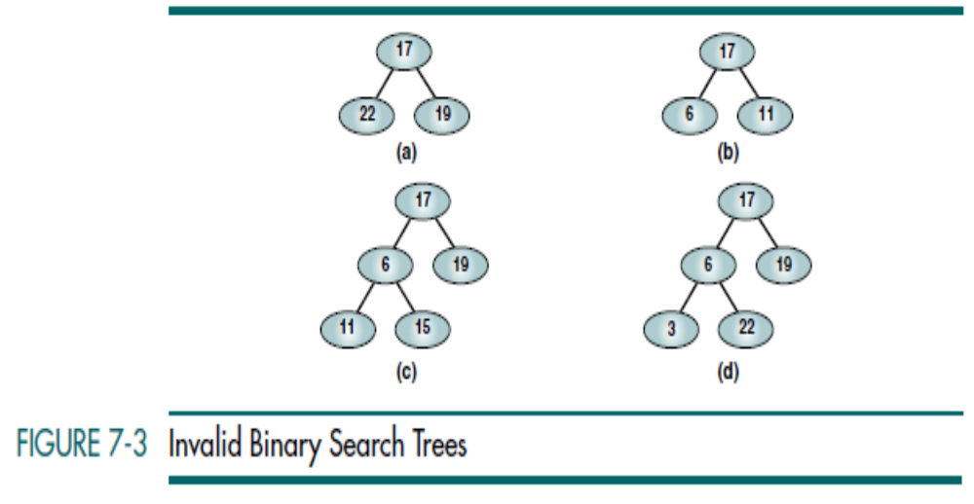
Data Structures: A Pseudocode Approach with C

Slide 21
BST Operations
Traversals
Searches
  Find the Smallest Node
  Find the Largest Node
  BST Search
Insertion
Deletion
Data Structures: A Pseudocode Approach with C

Slide 22
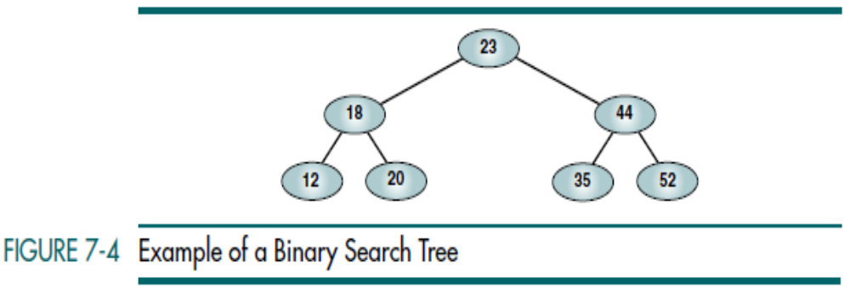



Preorder BST Traversal
Postorder BST Traversal
Inorder BST Traversal
Data Structures: A Pseudocode Approach with C

